Slide 1
A Platform for Personal Information Management and Integration
Xin (Luna) Dong and Alon Halevy
University of Washington

Slide 2








Is Your Personal Information a Mine or a Mess?
Intranet
Internet
Notes:
Mention Tim-Bernslee
PIM workshop last VLDB?

Slide 3

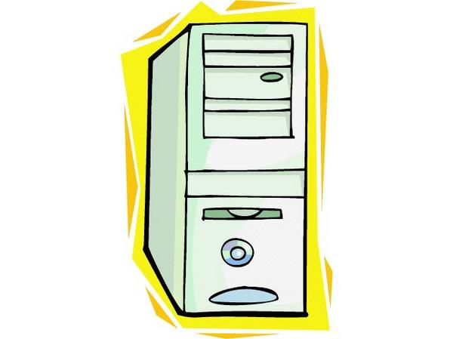

Is Your Personal Information a Mine or a Mess?
Intranet
Internet
Notes:
Mention Tim-Bernslee
PIM workshop last VLDB?

Slide 4
Questions Hard to Answer
Find my SEMEX paper and the presentation slides (maybe in an attachment).

Slide 5
Index Data from Different Sources
E.g. Google, MSN desktop search
Intranet
Internet
Notes:
Mention Tim-Bernslee
PIM workshop last VLDB?

Slide 6
Questions Hard to Answer
Find my SEMEX paper and the presentation slides (maybe in an attachment).
Find me the people working on SEMEX
Find me all the “schema matching” papers by my advisor
List me the phone numbers of my coauthors

Slide 7
Organize Data in a Semantically Meaningful Way
Co-authors
Intranet
Internet
Notes:
Mention Tim-Bernslee
PIM workshop last VLDB?

Slide 8
Questions Hard to Answer
Find my SEMEX paper and the presentation slides (maybe in an attachment).
Find me the people working on SEMEX
Find me all the “schema matching” papers by my advisor
List me the phone numbers of my coauthors
Find me the authors of CIDR’05 papers, who have sent me emails in the last 2 years

Slide 9
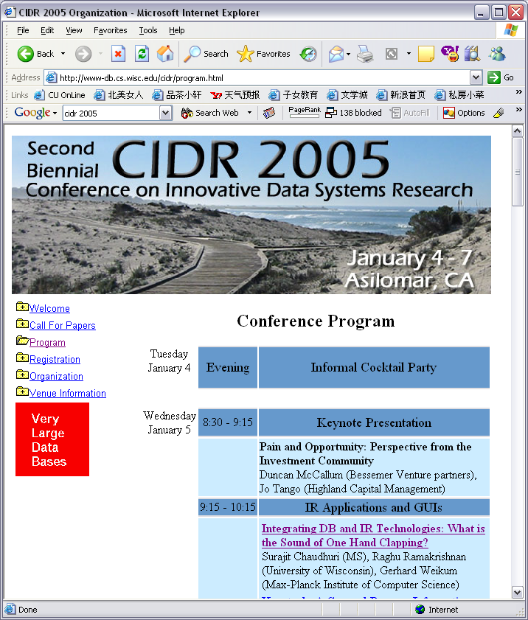
Integrate Organizational and Public Data with Personal Data
Intranet
Internet
Notes:
Mention Tim-Bernslee
PIM workshop last VLDB?

Slide 10


SEMEX (SEMantic EXplorer)
– I. Provide a Logical View of Data
Person
Homepage
Web Page
Cached
Organizer,
Participants
Document
Author
Event
Sender,
Recipients
Softcopy
Softcopy
Message
Paper
Presentation
Cites
Mail & calendar
Papers
HTML
Files
Presentations

Slide 11
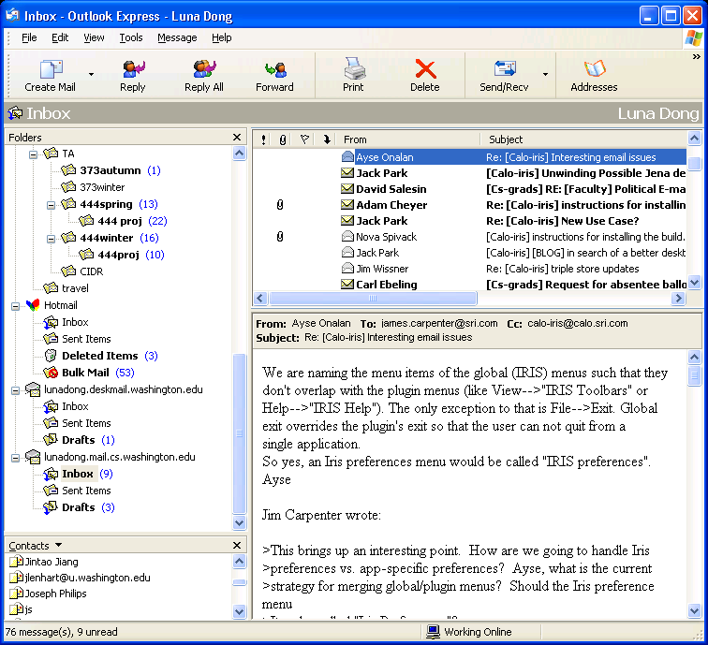
SEMEX (SEMantic EXplorer)
– II. On-the-fly Data Integration
Person
Homepage
Web Page
Cached
Organizer,
Participants
Document
Author
Event
Sender,
Recipients
Softcopy
Softcopy
Message
Paper
Presentation
Cites

Slide 12
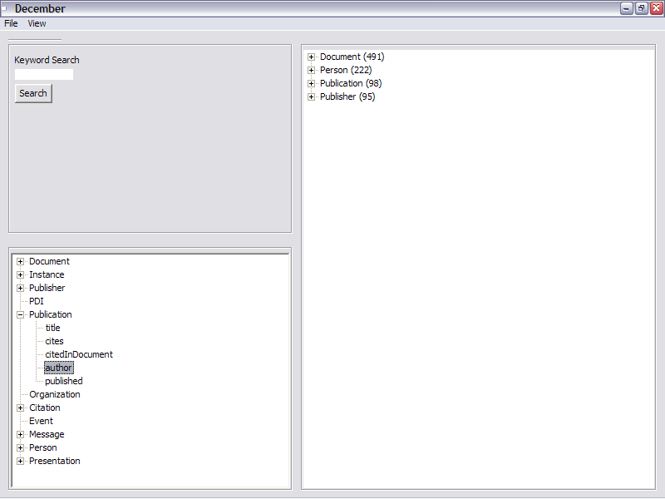
Browse by Associations

Slide 13
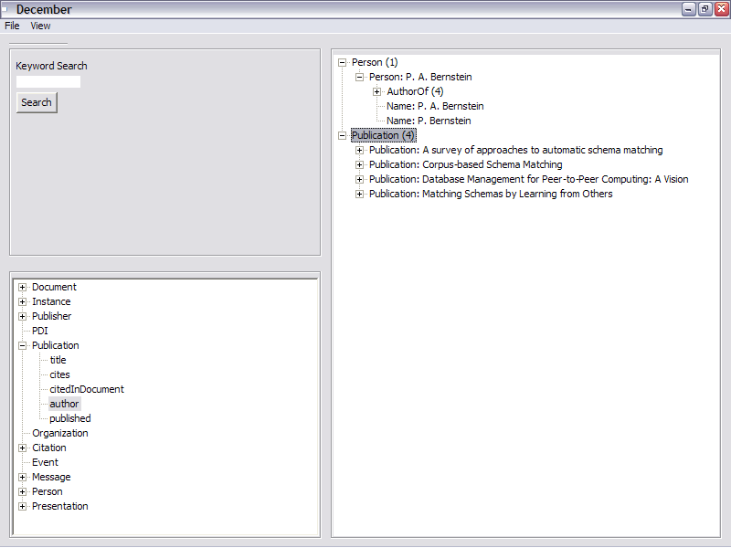
Browse by Associations
“A survey of approaches to automatic schema matching”
“Corpus-based schema matching”
“Database management for peer-to-peer computing: A vision”
“Matching schemas by learning from others”
“A survey of approaches to automatic schema matching”
“Corpus-based schema matching”
“Database management for peer-to-peer computing: A vision”
“Matching schemas by learning from others”
Publication
Bernstein

Slide 14
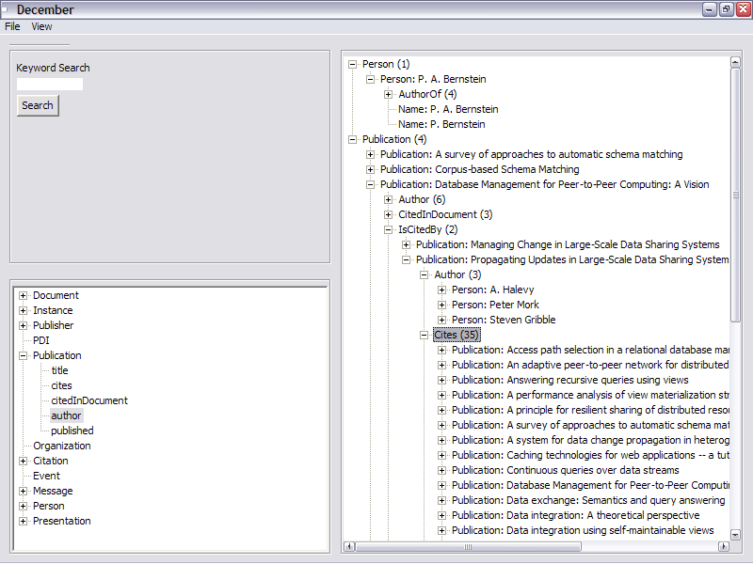
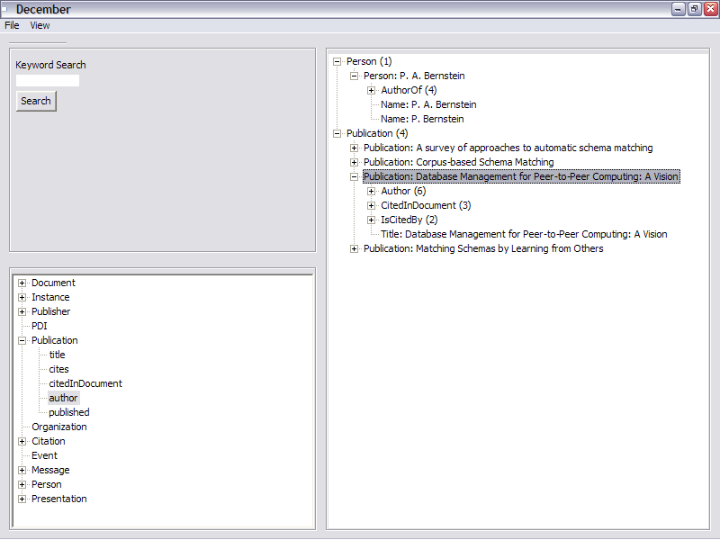
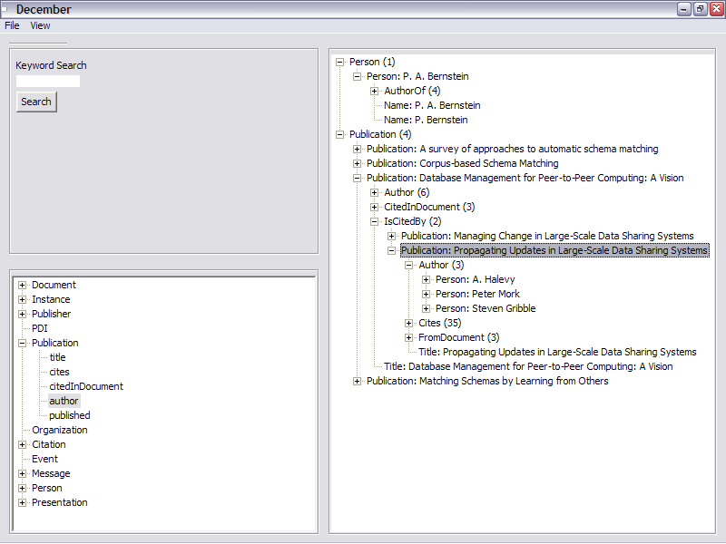
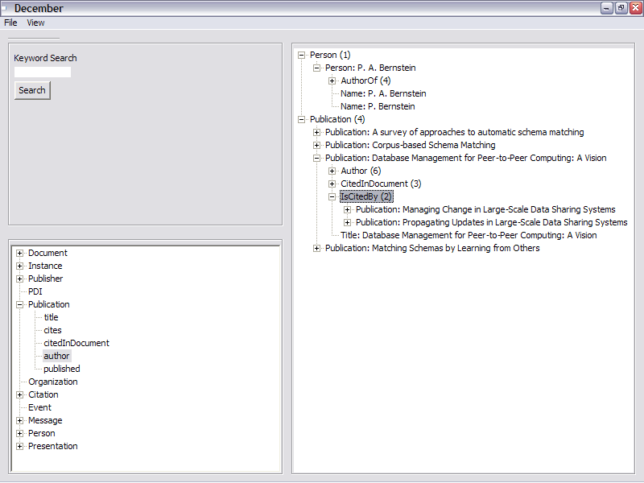
Browse by Associations
Cited by
Publication
Publication
Citations
Bernstein

Slide 15
An Ideal PIM is a Magic Wand

Slide 16
An Ideal PIM is a Magic Wand

Slide 17
Main Goals of Semex
How can we create an ‘AHA!’ browsing experience?
How can we leverage the PIM (Personal Information Management) environment and knowledge to increase productivity?

Slide 18
Outline
Problem definition and project goals
Technical issues:
  Semex architecture
  Reference reconciliation
  Importing external data sources
  Domain model personalization
Overarching PIM Themes

Slide 19
System Architecture
Person
Homepage
Web Page
Cached
Organizer,
Participants
Document
Author
Event
Sender,
Recipients
Softcopy
Softcopy
Message
Paper
Presentation
Cites
Mail & calendar
Papers
HTML
Files
Presentations

Slide 20
System Architecture
Domain Model
Data Repository
Reference
Reconciliation
Extracted
External
Simple
Defined
Associations
Objects
Word
Excel
PPT
PDF
Bibtex
Latex
Email
Contacts

Slide 21
System Architecture
Core
Domain Model
Domain model
personalization
Data Repository
Searcher and
browser
Data analyzer
Reference
Reconciliation
Extracted
External
Simple
Defined
External data
importer
Associations
Objects
Extractor
plug-ins
Word
Excel
PPT
PDF
Bibtex
Latex
Email
Contacts

Slide 22
Outline
Problem definition and project goals
Technical issues:
  Semex architecture
  Reference reconciliation
  Importing external data sources
  Domain model personalization
Overarching PIM Themes

Slide 23
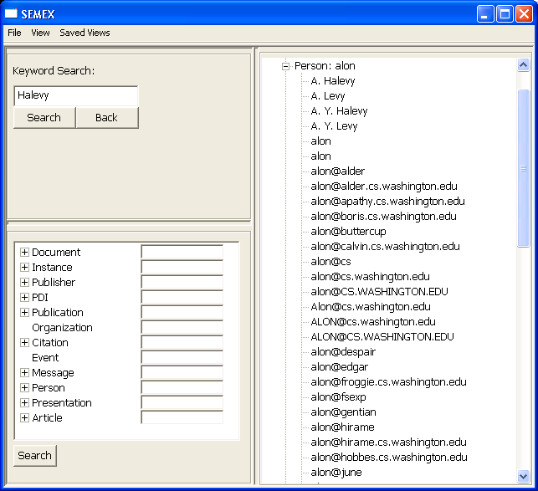
Reference Reconciliation

Slide 24
Reference Reconciliation
A very active area of research in Databases, Data Mining and AI
Typically assume matching tuples from a single table
  Approaches based on pair-wise comparisons
Harder in our context

Slide 25
Challenges
Article: a₁=(“Bounds on the Sample Complexity of Bayesian Learning”, “703-746”, {p₁,p₂,p₃}, c₁)
a₂=(“Bounds on the sample complexity of bayesian learning”,
“703-746”, {p₄,p₅,p₆}, c₂)
Venue: c₁=(“Computational learning theory”, “1992”, “Austin, Texas”)
c₂=(“COLT”, “1992”, null)
Person: p₁=(“David Haussler”, null)
p₂=(“Michael Kearns”, null)
p₃=(“Robert Schapire”, null)
p₄=(“Haussler, D.”, null)
p₅=(“Kearns, M. J.”, null)
p₆=(“Schapire, R.”, null)

Slide 26
Challenges
Article: a₁=(“Bounds on the Sample Complexity of Bayesian Learning”, “703-746”, {p₁,p₂,p₃}, c₁)
a₂=(“Bounds on the sample complexity of bayesian learning”,
“703-746”, {p₄,p₅,p₆}, c₂)
Venue: c₁=(“Computational learning theory”, “1991”, “Austin, Texas”)
c₂=(“COLT”, “1992”, null)
Person: p₁=(“David Haussler”, null)
p₂=(“Michael Kearns”, null)
p₃=(“Robert Schapire”, null)
p₄=(“Haussler, D.”, null)
p₅=(“Kearns, M. J.”, null)
p₆=(“Schapire, R.”, null)
p₇=(“Robert Schapire”, “schapire@research.att.com”)
p₈=(null, “mkearns@cis.uppen.edu”)
p₉=(“mike”, “mkearns@cis.uppen.edu”)
2. Limited
Information
1. Multiple
Classes
?
3. Multi-value
Attributes
?

Slide 27
Intuition—
Exploit Context Information
Exploit context information
  E.g. name v.s. email
  E.g. contact list
Propagate similarities between different types of objects
  E.g., reconciling papers helps reconcile conferences
Exploit richness of merged references
  E.g., remember alternate representations of entities

Slide 28
Outline
Problem definition and project goals
Technical issues:
  Semex architecture
  Reference reconciliation
  Importing external data sources
  Domain model personalization
Overarching PIM Themes

Slide 29
Importing External Data Sources
Person
Homepage
Web Page
Cached
Organizer,
Participants
Document
Author
Event
Sender,
Recipients
Softcopy
Softcopy
Message
Paper
Presentation
Cites

Slide 30
Challenges—
On-thy-fly Data Integration
Current data integration study focuses on integrating enterprise data
  Large-scale, heavy-weight
  Performed by professional technicians
  Built to support very frequently occurring queries
The PIM context presents unique challenges
  Small-scale, light-weight
  Performed by non-technical savvy
  Doing transient queries (done only once or twice, or use different pieces of data)

Slide 31
Intuition—
Using Past Experiences and Knowledge
We have a large number of instances
  E.g., importing DBLP – help from overlapping paper instances
  [Doan et al, Sigmod’04][Etzioni et al, 1995]
We know a lot about the domain model
  Schema matching work
  [Doan et al, Sigmod’01][Madhavan et al, ICDE’05]
Others have imported similar (or the same) data sources

Slide 32
Outline
Problem definition and project goals
Technical issues:
  Semex architecture
  Reference reconciliation
  Importing external data sources
  Domain model personalization
Overarching PIM Themes

Slide 33
The Domain Model
The Semex core provides very basic classes and associations
Users will need to personalize further
Person
Homepage
Web Page
Cached
Organizer,
Participants
Document
Author
Event
Sender,
Recipients
Softcopy
Softcopy
Message
cite
Paper
Presentation

Slide 34
Challenges
Easy-to-use for non-technical users
  Suggest appropriate modifications
Make the fragments fit together
Guarantee high efficiency of updating and querying

Slide 35
Intuition—
Suggest Changes from Past Experiences
Strategy: mix and match from small components
  May come with extractor plug-ins
  A by-product of importing external data sources
  Learn from other people’s domain models

Slide 36
Outline
Problem definition and project goals
Technical issues:
  Semex architecture
  Reference reconciliation
  Importing external data sources
  Domain model personalization
Overarching PIM Themes

Slide 37
Overarching PIM Themes
PERSONAL
It is PERSONAL data!
  What is the right granularity for modeling personal data?
Manipulate any kind of INFORMATION
  How to combine structured and un-structured data?
Data and “schema” evolve over time
  How to do life-long data management?
Bring the benefits of data MANAGEMENT to users
  How to build a system supporting users in their own habitat?
INFORMATION
MANAGEMENT

Slide 38
Related Work
Personal Information Management Systems
  Indexing
    Stuff I’ve Seen (MSN Desktop Search)
    [Dumais et al., 2003]
    Google Desktop Search [2004]
  Richer relationships
    LifeStreams [Freeman and Gelernter, 1996]
    Placeless Documents [Dourish et al., 2000]
    MyLifeBits [Gemmell et al., 2002]
  Objects and Associations
    Haystack [Karger et al., 2005]

Slide 39
Summary
60 years passed since the personal Memex was envisioned
  It’s time to get serious
  Great challenges for data management
The goal of Semex
  Set up a platform for applications that increase user’s productivity
  Bring benefits of data management to ordinary users
There is a lot of technology to build on. It is not a pipe dream!

Slide 40
A Platform for Personal Information Management and Integration
@CIDR 2005
Xin (Luna) Dong and Alon Halevy
University of Washington
data.cs.washington.edu/semex

